Slide 1
Hadoop Installation
by
Dr. U.S.N. Raju
Asst. Professor, Dept. of CS&E,
N.I.T. Warangal
Big Image Data Processing on Hadoop
Notes:
Now it is my privilege to present before you brief presentation about the department and detailed presentation for evaluating B Tech porgram in CSE in line with e-sar application submitted to NBA.

Slide 2
Hadoop can be installed in your systems in three different modes:
    Local Standalone mode
    Pseudo distributed mode
    Fully distributed mode
Big Image Data Processing on Hadoop
Notes:
Now it is my privilege to present before you brief presentation about the department and detailed presentation for evaluating B Tech porgram in CSE in line with e-sar application submitted to NBA.

Slide 3
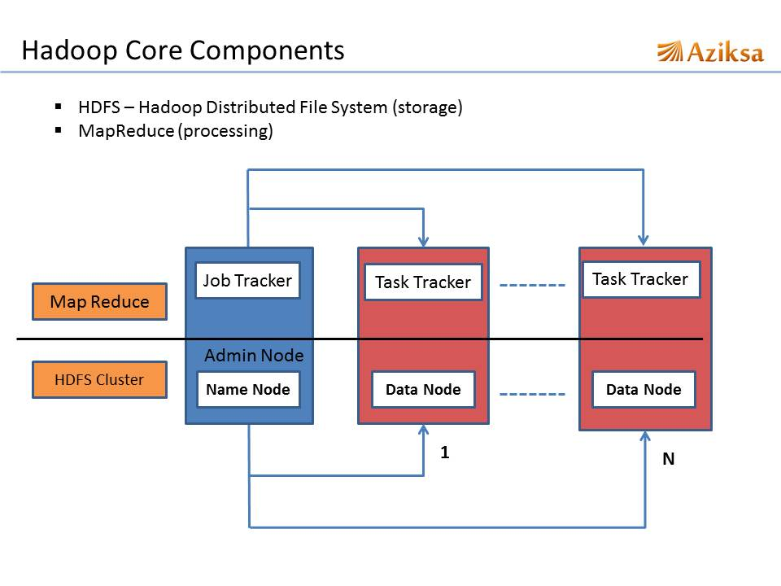
Big Image Data Processing on Hadoop
Notes:
Now it is my privilege to present before you brief presentation about the department and detailed presentation for evaluating B Tech porgram in CSE in line with e-sar application submitted to NBA.

Slide 4
Local Standalone mode:
This is the default mode. In this mode, all the components of Hadoop, such as NameNode, DataNode, JobTracker and TaskTracker, run on a single Java process.
Big Image Data Processing on Hadoop
Notes:
Now it is my privilege to present before you brief presentation about the department and detailed presentation for evaluating B Tech porgram in CSE in line with e-sar application submitted to NBA.

Slide 5
Pseudo-distributed mode:
In this mode, a separate JVM is spawned for each of the Hadoop components and they communicate across network sockets, effectively giving a fully functioning minicluster on a single host.
Big Image Data Processing on Hadoop
Notes:
Now it is my privilege to present before you brief presentation about the department and detailed presentation for evaluating B Tech porgram in CSE in line with e-sar application submitted to NBA.

Slide 6
Fully Distributed mode:
In this mode, Hadoop is spread across multiple machines, some of which will be general-purpose workers and others will be dedicated hosts for components, such as NameNode and JobTracker.
Big Image Data Processing on Hadoop
Notes:
Now it is my privilege to present before you brief presentation about the department and detailed presentation for evaluating B Tech porgram in CSE in line with e-sar application submitted to NBA.

Slide 7
Environment Setup for Hadoop
Hadoop is supported by Ubuntu/GNU/Linux platform and its flavors.
Therefore, we have to install a Linux operating system for setting up Hadoop environment.
In case you have an OS other than Linux, you can install a Virtualbox software in it and have Linux inside the Virtualbox.
Big Image Data Processing on Hadoop
Notes:
Now it is my privilege to present before you brief presentation about the department and detailed presentation for evaluating B Tech porgram in CSE in line with e-sar application submitted to NBA.

Slide 8
I. Local Standalone mode
Big Image Data Processing on Hadoop
Notes:
Now it is my privilege to present before you brief presentation about the department and detailed presentation for evaluating B Tech porgram in CSE in line with e-sar application submitted to NBA.

Slide 9
Step-1: Creating a User in Ubuntu:
At the beginning, it is recommended to create a separate user for Hadoop to isolate Hadoop file system from Unix file system.
In addition to this, as we need to prepare cluster, first create group and then a user in that group.
Big Image Data Processing on Hadoop
Notes:
Now it is my privilege to present before you brief presentation about the department and detailed presentation for evaluating B Tech porgram in CSE in line with e-sar application submitted to NBA.

Slide 10
Follow the steps given below to create a group and a user in that group:
$ clear
$ sudo addgroup giet_hd_group
$ sudo adduser –ingroup giet_hd_group giet_hd_user
Password is giet in both the cases
Big Image Data Processing on Hadoop
Notes:
Now it is my privilege to present before you brief presentation about the department and detailed presentation for evaluating B Tech porgram in CSE in line with e-sar application submitted to NBA.

Slide 11
Change the user form lenova… to giet_hd_user
$ su giet_hd_user
$ cd
After this, if you type pwd, we should get giet_hd_user
Big Image Data Processing on Hadoop
Notes:
Now it is my privilege to present before you brief presentation about the department and detailed presentation for evaluating B Tech porgram in CSE in line with e-sar application submitted to NBA.

Slide 12
Step-2: SSH Setup and Key Generation in Ubuntu:
SSH setup is required to do different operations on a cluster such as starting, stopping, distributed daemon shell operations. To authenticate different users of Hadoop, it is required to provide public/private key pair for a Hadoop user and share it with different users.
Big Image Data Processing on Hadoop
Notes:
Now it is my privilege to present before you brief presentation about the department and detailed presentation for evaluating B Tech porgram in CSE in line with e-sar application submitted to NBA.

Slide 13
The following commands are used for generating
A key value pair using SSH.
Copy the public keys from id_rsa.pub to authorized_keys and
Provide the owner with read and write permissions to authorized_keys file respectively.
$ ssh-keygen -t rsa
$ cat ~/.ssh/id_rsa.pub >> /.ssh/authorized_keys $ chmod 0600 ~/.ssh/authorized_keys
Big Image Data Processing on Hadoop
Notes:
Now it is my privilege to present before you brief presentation about the department and detailed presentation for evaluating B Tech porgram in CSE in line with e-sar application submitted to NBA.

Slide 14
Step-3: Installing Java
All of you type this command
$ uname –i
As Java is already installed in your computer, You will get either
    x86_64 or
    i686 or
    something else
Big Image Data Processing on Hadoop
Notes:
Now it is my privilege to present before you brief presentation about the department and detailed presentation for evaluating B Tech porgram in CSE in line with e-sar application submitted to NBA.

Slide 15
Then open a text editor using search in ubuntu.
Create a file abc.txt
Those who got x86_64, type these two lines into abc.txt
$ export JAVA_HOME=/usr/lib/jvm/java-7-openjdk-amd64
$ export PATH=$PATH:$JAVA_HOME/bin
Those who got other than x86_64, type these two lines into abc.txt
$ export JAVA_HOME=/usr/lib/jvm/java-7-openjdk-i386
$ export PATH=$PATH:$JAVA_HOME/bin
Big Image Data Processing on Hadoop
Notes:
Now it is my privilege to present before you brief presentation about the department and detailed presentation for evaluating B Tech porgram in CSE in line with e-sar application submitted to NBA.

Slide 16
Step-4: Download Hadoop
As Hadoop is already downloaded in one computer in this lab, you need to copy that downloaded Hadoop into your computer. So follow the following commands to do this.
$ pwd (It must be giet_hd_user)
$ wget ftp://172.168.10.168/Downloads/hadoop-2.6.0.tar.gz --user=lenova
--password=giet
By doing this, the download Hadoop software which is in the tar form will be copied into giet_hd_user.
Big Image Data Processing on Hadoop
Notes:
Now it is my privilege to present before you brief presentation about the department and detailed presentation for evaluating B Tech porgram in CSE in line with e-sar application submitted to NBA.

Slide 17
Step-5: Untar the Hadoop
To untar the Hadoop in giet_hd_user follow the following commands.
$ tar zxf hadoop-2.6.0.tar.gz
$ ls –lrt
Big Image Data Processing on Hadoop
Notes:
Now it is my privilege to present before you brief presentation about the department and detailed presentation for evaluating B Tech porgram in CSE in line with e-sar application submitted to NBA.

Slide 18
Step-6: Setting the Hadoop Path
Just like your Java path, Now we are doing it for Hadoop path.
Open the file abc.txt, where you have already typed two lines in that previously
Type the following two lines into abc.txt
$ export HADOOP_HOME=/home/giet_hd_user/hadoop-2.6.0
$ export PATH=$PATH:$HADOOP_HOME/bin
Big Image Data Processing on Hadoop
Notes:
Now it is my privilege to present before you brief presentation about the department and detailed presentation for evaluating B Tech porgram in CSE in line with e-sar application submitted to NBA.

Slide 19
Step-7: Updating the bashrc file
To set the environmental changes, i.e. to keep the java path and hadoop path to work correctly in all ‘terminals’, we have to save the changes to ‘bashrc file’ of the current user.
Actually, bashrc is a hidden file. So to open this file, we have to use .bashrc.
Use the following commands to do this.
$ nano .bashrc
bashrc will be opened,
go to the end of the file
paste the 4-lines from abc.txt into this bashrc file
Save the bashrc file
Big Image Data Processing on Hadoop
Notes:
Now it is my privilege to present before you brief presentation about the department and detailed presentation for evaluating B Tech porgram in CSE in line with e-sar application submitted to NBA.

Slide 20
Step-8:Now use the command
$ source ~/.bashrc
(This command is to refresh the terminal with updated bashrc)
Big Image Data Processing on Hadoop
Notes:
Now it is my privilege to present before you brief presentation about the department and detailed presentation for evaluating B Tech porgram in CSE in line with e-sar application submitted to NBA.

Slide 21
Step-9: Just verify, whether everything is done properly or not , to check the path settings are reflected or not.
$ echo $JAVA_HOME
$ echo $HADOOP_HOME
$ echo $PATH (It will show both Java path and Hadoop Path)
Big Image Data Processing on Hadoop
Notes:
Now it is my privilege to present before you brief presentation about the department and detailed presentation for evaluating B Tech porgram in CSE in line with e-sar application submitted to NBA.

Slide 22
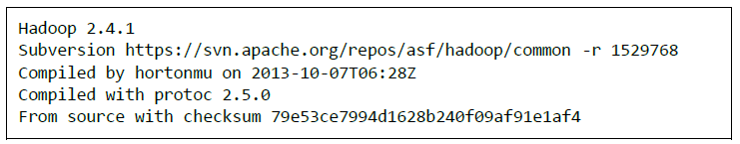
Step-10: Now, Check whether Hadoop is working or not. (Just like Java -version)
$ hadoop version
Now Hadoop on Local Standalone mode is Ready
Big Image Data Processing on Hadoop
Notes:
Now it is my privilege to present before you brief presentation about the department and detailed presentation for evaluating B Tech porgram in CSE in line with e-sar application submitted to NBA.

Slide 23
Step-11: Now, We run a program on Hadoop from the already existing examples given.
$ cp $HADOOP_HOME/share/hadoop/mapreduce/hadoop-mapreduce-examples-2.6.0.jar . (This dot is must, to copy into present working director)
$ ls -lrt
This command copies the examples into present working directory i.e. giet_hd_user
Big Image Data Processing on Hadoop
Notes:
Now it is my privilege to present before you brief presentation about the department and detailed presentation for evaluating B Tech porgram in CSE in line with e-sar application submitted to NBA.

Slide 24
Step-12: Now, we will execute wordcount program.
For this, we nee input directory, from which the input will be taken by the program.
And output will be written to another directory.
So First create a directory named as input_dir and copy some text files into this directory.
$ mkdir input_dir
$ cp $HADOOP_HOME/*.txt input_dir
$ cd input_dir
$ ls –lrt
$ cd .. //to come to giet_hd_user
Big Image Data Processing on Hadoop
Notes:
Now it is my privilege to present before you brief presentation about the department and detailed presentation for evaluating B Tech porgram in CSE in line with e-sar application submitted to NBA.

Slide 25
Step-13: Now, use the following command to execute the program
$ hadoop jar hadoop-mapreduce-examples-2.6.0.jar wordcount input_dir output_dir
Jar file name in the current directory
This is keyword just like java
This is output directory
This is input directory
This is the file name
Big Image Data Processing on Hadoop
Notes:
Now it is my privilege to present before you brief presentation about the department and detailed presentation for evaluating B Tech porgram in CSE in line with e-sar application submitted to NBA.

Slide 26
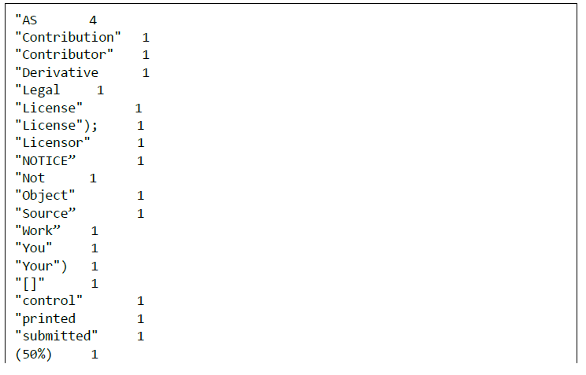
Step-14: To see the output
$ cd output_dir
$ ls –lrt
$ cat part-r-00000
Big Image Data Processing on Hadoop
Notes:
Now it is my privilege to present before you brief presentation about the department and detailed presentation for evaluating B Tech porgram in CSE in line with e-sar application submitted to NBA.

Slide 27
II. Pseudo-distributed mode
Big Image Data Processing on Hadoop
Notes:
Now it is my privilege to present before you brief presentation about the department and detailed presentation for evaluating B Tech porgram in CSE in line with e-sar application submitted to NBA.

Slide 28
Step-1: Setting Up Hadoop
You can set Hadoop environment variables by appending the following commands to .bashrc and then save it
export HADOOP_HOME=/home/giet_hd_user/hadoop-2.6.0
export PATH=$PATH:$HADOOP_HOME/bin
export HADOOP_MAPRED_HOME=$HADOOP_HOME
export HADOOP_COMMON_HOME=$HADOOP_HOME
export HADOOP_HDFS_HOME=$HADOOP_HOME
export YARN_HOME=$HADOOP_HOME
export HADOOP_CONF_DIR=$HADOOP_HOME/etc/hadoop
export YARN_CONF_DIR=$HADOOP_HOME/etc/hadoop
export HADOOP_COMMON_LIB_NATIVE_DIR=$HADOOP_HOME/lib/native
export HADOOP_OPTS=”-Djava.library.path=$HADOOP_HOME/lib”
export PATH=$PATH:$HADOOP_HOME/sbin
Big Image Data Processing on Hadoop
Notes:
Now it is my privilege to present before you brief presentation about the department and detailed presentation for evaluating B Tech porgram in CSE in line with e-sar application submitted to NBA.

Slide 29
Step-2:Now use the command
$ source ~/.bashrc
(This command is to refresh the terminal with updated bashrc)
Big Image Data Processing on Hadoop
Notes:
Now it is my privilege to present before you brief presentation about the department and detailed presentation for evaluating B Tech porgram in CSE in line with e-sar application submitted to NBA.

Slide 30
Step-3: Hadoop Configuration
You can find all the Hadoop configuration files in the location “$HADOOP_HOME/etc/hadoop”.
It is required to make changes in those configuration files according to your Hadoop infrastructure.
$ cd $HADOOP_HOME/etc/hadoop
$ pwd
Big Image Data Processing on Hadoop
Notes:
Now it is my privilege to present before you brief presentation about the department and detailed presentation for evaluating B Tech porgram in CSE in line with e-sar application submitted to NBA.

Slide 31
In order to develop Hadoop programs in java, you have to reset the java environment variables in hadoop-env.sh file by replacing JAVA_HOME value with the location of java in your system.
$ nano hadoop-env.sh
Those who got x86_64 (uname -i), type
$ export JAVA_HOME=/usr/lib/jvm/java-7-openjdk-amd64
Those who got other than x86_64, type
$ export JAVA_HOME=/usr/lib/jvm/java-7-openjdk-i386
Big Image Data Processing on Hadoop
Notes:
Now it is my privilege to present before you brief presentation about the department and detailed presentation for evaluating B Tech porgram in CSE in line with e-sar application submitted to NBA.

Slide 32
You need to configure the following files also
    core-site.xml
    hdfs-site.xml
    yarn-site-xml
    mapred-site.xml
Big Image Data Processing on Hadoop
Notes:
Now it is my privilege to present before you brief presentation about the department and detailed presentation for evaluating B Tech porgram in CSE in line with e-sar application submitted to NBA.

Slide 33
Step-4: Configuring core-site.xml
The core-site.xml file contains information such as the port number used for Hadoop instance, memory allocated for the file system, memory limit for storing the data, and size of Read/Write buffers.
Open the core-site.xml and add the following properties in between <configuration>, </configuration> tags.
$ nano core-site.xml
<configuration>
<property>
<name>fs.default.name</name>
<value>hdfs://localhost:9000</value>
</property>
</configuration>
Big Image Data Processing on Hadoop
Notes:
Now it is my privilege to present before you brief presentation about the department and detailed presentation for evaluating B Tech porgram in CSE in line with e-sar application submitted to NBA.

Slide 34
Step-5: Configuring hdfs-site.xml :
$ nano hdfs-site.xml
The hdfs-site.xml file contains information such as the value of replication data, namenode path, and datanode paths of your local file systems. It means the place where you want to store the Hadoop infrastructure.
Let us assume the following data.
dfs.replication (data replication value) = 1
(In the below given path /nitw_cvhd_user2/ is the user name.
hadoopinfra/hdfs/namenode is the directory created by hdfs file system.)
namenode path = //home/nitw_cvhd_user2/ hadoopinfra/hdfs/namenode
(hadoopinfra/hdfs/datanode is the directory created by hdfs file system.)
datanode path = //home/nitw_cvhd_user2/hadoopinfra/hdfs/datanode
Big Image Data Processing on Hadoop
Notes:
Now it is my privilege to present before you brief presentation about the department and detailed presentation for evaluating B Tech porgram in CSE in line with e-sar application submitted to NBA.

Slide 35
<configuration>
<property>
<name>dfs.replication</name>
<value>1</value>
</property>
</configuration>
<configuration>
<property>
<name>dfs.name.dir </name>
<value>file:///home/nitw_cvhd_user2/hadoopinfra/hdfs/namenode</value>
</property>
</configuration>
<configuration>
<property>
<name> dfs.data.dir</name>
<value>file:///home/nitw_cvhd_user2/hadoopinfra/hdfs/datanode </value>
</property>
</configuration>
Big Image Data Processing on Hadoop
Notes:
Now it is my privilege to present before you brief presentation about the department and detailed presentation for evaluating B Tech porgram in CSE in line with e-sar application submitted to NBA.

Slide 36
Step-6: Configuring yarn-site.xml
$ nano yarn-site.xml
This file is used to configure yarn into Hadoop. Open the yarn-site.xml file and add the following properties in between the <configuration>, </configuration> tags in this file.
<configuration>
<property>
<name> yarn.nodemanager.aux-services </name>
<value> mapreduce_shuffle </value>
</property>
</configuration>
Big Image Data Processing on Hadoop
Notes:
Now it is my privilege to present before you brief presentation about the department and detailed presentation for evaluating B Tech porgram in CSE in line with e-sar application submitted to NBA.

Slide 37
Step-7: Configuring mapred-site.xml
This file is used to specify which MapReduce framework we are using.
By default, Hadoop contains a template of mapred-site.xml.template First of all, it is required to copy the file from mapred-site,xml.template to mapred-site.xml file using the following command.
$ cp mapred-site.xml.template mapred-site.xml
Then open the mapred-site.xml and add the following properties in between the <configuration> </configuration> tags.
<configuration>
<property>
<name> mapreduce.framework.name </name>
<value> yarn </value>
</property>
</configuration>
Big Image Data Processing on Hadoop
Notes:
Now it is my privilege to present before you brief presentation about the department and detailed presentation for evaluating B Tech porgram in CSE in line with e-sar application submitted to NBA.

Slide 38
Step-8: Verifying Hadoop Installation
Goto home directory.
$ cd
$ hdfs namenode –format
Big Image Data Processing on Hadoop
Notes:
Now it is my privilege to present before you brief presentation about the department and detailed presentation for evaluating B Tech porgram in CSE in line with e-sar application submitted to NBA.

Slide 39
Step-9: Verifying Hadoop dfs
Goto home directory
$ start–dfs.sh
$ start–yarn.sh
hdfs dfs –mkdir hdfs://localhost:9000/necpinput
hdfs dfs –ls hdfs://localhost:9000/
cd necinput
hdfs dfs –put file1 hdfs://localhost:9000/necinput
hdfs dfs –put file2 hdfs://localhost:9000/necinput
hadoop jar hadoop-mapreduce-examples-2.6.0.jar wordcount hdfs://localhost:9000/necinput hdfs://localhost:9000/output
hdfs dfs –cat hdfs://localhost:9000/output/part-r-00000
Big Image Data Processing on Hadoop
Notes:
Now it is my privilege to present before you brief presentation about the department and detailed presentation for evaluating B Tech porgram in CSE in line with e-sar application submitted to NBA.

Slide 40
Before proceeding further, you need to make sure that Hadoop is working fine. Just issue the following command:
$ hadoop version
If everything is fine with your setup, then you should see the following result:
It means your Hadoop's pseudo distributed mode setup is working fine. By default, Hadoop is configured to run in a non-distributed mode on a single machine.
Big Image Data Processing on Hadoop
Notes:
Now it is my privilege to present before you brief presentation about the department and detailed presentation for evaluating B Tech porgram in CSE in line with e-sar application submitted to NBA.

Slide 41
Example :
$HADOOP_HOME/share/hadoop/mapreduce/hadoop-mapreduce-examples-2.2.0.jar
Let's have an input directory where we will push a few files and our requirement is to count the total number of words in those files. To calculate the total number of words, we do not need to write our MapReduce, provided the .jar file contains the implementation for word count. You can try other examples using the same .jar file; just issue the following commands to check supported MapReduce functional programs by hadoop-mapreduce-examples-2.2.0.jar file.
Big Image Data Processing on Hadoop
Notes:
Now it is my privilege to present before you brief presentation about the department and detailed presentation for evaluating B Tech porgram in CSE in line with e-sar application submitted to NBA.

Slide 42
Let's have an input directory where we will push a few files and our requirement is to count the total number of words in those files. To calculate the total number of words, we do not need to write our MapReduce, provided the .jar file contains the implementation for word count. You can try other examples using the same .jar file; just issue the following commands to check supported MapReduce functional programs by hadoop-mapreduce-examples-2.2.0.jar file.
$ hadoop jar $HADOOP_HOME/share/hadoop/mapreduce/hadoop-mapreduce-examples-2.2.0.jar
Big Image Data Processing on Hadoop
Notes:
Now it is my privilege to present before you brief presentation about the department and detailed presentation for evaluating B Tech porgram in CSE in line with e-sar application submitted to NBA.

Slide 43

Step 1
to work.
ls -lrt /usr/lib/jvm
It will give the following files in your input directory:
These files have been copied from the Hadoop installation home directory. For your experiment, you can have different and large sets of files.
Big Image Data Processing on Hadoop
Notes:
Now it is my privilege to present before you brief presentation about the department and detailed presentation for evaluating B Tech porgram in CSE in line with e-sar application submitted to NBA.

Slide 44
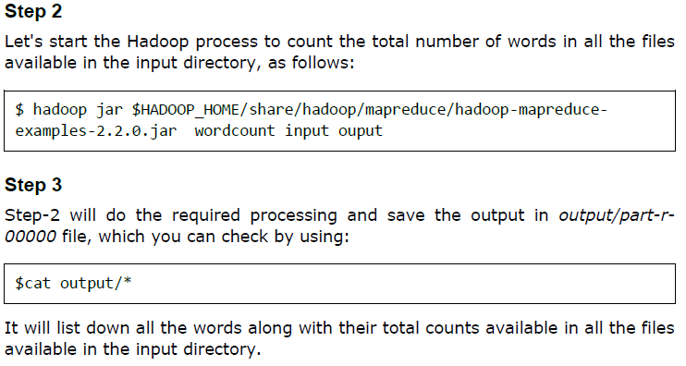
Big Image Data Processing on Hadoop
Notes:
Now it is my privilege to present before you brief presentation about the department and detailed presentation for evaluating B Tech porgram in CSE in line with e-sar application submitted to NBA.

Slide 45
III. Fully-Distributed Mode
Big Image Data Processing on Hadoop
Notes:
Now it is my privilege to present before you brief presentation about the department and detailed presentation for evaluating B Tech porgram in CSE in line with e-sar application submitted to NBA.

Slide 46
Prerequisites
Configuring single-node clusters first,here we have used two single node clusters. Shutdown each single-node cluster with the following comman.
$stop-all.sh
Networking
Update /etc/hosts on all machines. Put the alias to the ip addresses of all the machines. Here we are creating a cluster of 6 machines, one is master and other 5 are slaves.
$sudo gedit /etc/hosts
Add the following lines for two node cluster
192.168.192.103 (IP address of the master node) master
192.168.192.101 (IP address of the slave node) slave1
192.168.192.102 (IP address of the slave node) slave2
192.168.192.104 (IP address of the slave node) slave3
192.168.192.105 (IP address of the slave node) slave4
192.168.192.106 (IP address of the slave node) slave5
Big Image Data Processing on Hadoop
Notes:
Now it is my privilege to present before you brief presentation about the department and detailed presentation for evaluating B Tech porgram in CSE in line with e-sar application submitted to NBA.

Slide 47
ALL THE SLAVE NODES MUST REMAIN IDLE UNLESS SPECIFIED!
Big Image Data Processing on Hadoop
Notes:
Now it is my privilege to present before you brief presentation about the department and detailed presentation for evaluating B Tech porgram in CSE in line with e-sar application submitted to NBA.

Slide 48
SSH access
The nitw_cvhd_user2 user on the master must be able to connect:
To its own user account on the master.
$ssh usn in this context.
2. To the nitw_cvhd_user2 user account on other slaves via a password-less SSH login.
Add the usn (master) public SSH key using the following command
$ ssh-copy-id -i $HOME/.ssh/id_rsa.pub nitw_cvhd_user2@slave1
$ ssh-copy-id -i $HOME/.ssh/id_rsa.pub nitw_cvhd_user2@slave2
$ ssh-copy-id -i $HOME/.ssh/id_rsa.pub nitw_cvhd_user2@slave3
$ ssh-copy-id -i $HOME/.ssh/id_rsa.pub nitw_cvhd_user2@slave4
$ ssh-copy-id -i $HOME/.ssh/id_rsa.pub nitw_cvhd_user2@slave5
Big Image Data Processing on Hadoop
Notes:
Now it is my privilege to present before you brief presentation about the department and detailed presentation for evaluating B Tech porgram in CSE in line with e-sar application submitted to NBA.

Slide 49
Connect with user nitw_cvhd_user2 from the master to the user account nitw_cvhd_user2 on all slaves in 6 different terminals!
1. From master to master: nitw_cvhd_user2@selab103:~$ ssh master
2.From master to slave : nitw_cvhd_user2@selab103:~$ ssh slave1
which results in nitw_cvhd_user2@selab101:~$
From master to slave : nitw_cvhd_user2@selab103:~$ ssh slave2
which results in nitw_cvhd_user2@selab102:~$
From master to slave : nitw_cvhd_user2@selab103:~$ ssh slave3
which results in nitw_cvhd_user2@selab104:~$
From master to slave : nitw_cvhd_user2@selab103:~$ ssh slave4
which results in nitw_cvhd_user2@selab105:~$
From master to slave : nitw_cvhd_user2@selab103:~$ ssh slave5
which results in nitw_cvhd_user2@selab106:~$
Big Image Data Processing on Hadoop
Notes:
Now it is my privilege to present before you brief presentation about the department and detailed presentation for evaluating B Tech porgram in CSE in line with e-sar application submitted to NBA.

Slide 50
Now we need to inform the master name to Hadoop:
Create a file named masters in /home/hadoop-2.7.2/etc/hadoop directory
Add the name of master in masters file.
nitw_cvhd_user2@selab103:~$ cd /home/hadoop-2.7.2/etc/hadoop
nitw_cvhd_user2@selab103:~$ sudo gedit masters
Add the following line
master
Then, we need to inform the slaves’ names to Hadoop:
Edit the file named slaves in /home/hadoop-2.7.2/etc/hadoop directory
nitw_cvhd_user2@selab101 (2/4/5/6):~$ cd /home/hadoop-2.7.2/etc/hadoop
nitw_cvhd_user2@selab101 (2/4/5/6):~$ sudo gedit slaves
Add the following lines
slave1
slave2
slave3
slave4
slave5
Big Image Data Processing on Hadoop
Notes:
Now it is my privilege to present before you brief presentation about the department and detailed presentation for evaluating B Tech porgram in CSE in line with e-sar application submitted to NBA.

Slide 51
conf/*-site.xml (all machines)
Open this file in the conf directory
nitw_cvhd_user2@selab103:~/home/hadoop-2.7.2/etc/hadoop$ sudo gedit core-site.xml
nitw_cvhd_user2@selab101(2,4,5,6):~/home/hadoop-2.7.2/etc/hadoop$ sudo gedit core-site.xml
Change the fs.default.name parameter (in conf/core-site.xml), which specifies the NameNode (the HDFS master) host and port.
/home/hadoop-2.7.2/etc/hadoop/ core-site.xml (ALL machines .ie. Master as well as slave)
<property>
<name>fs.default.name</name>
<value>hdfs://master:54310</value>
</property>
Big Image Data Processing on Hadoop
Notes:
Now it is my privilege to present before you brief presentation about the department and detailed presentation for evaluating B Tech porgram in CSE in line with e-sar application submitted to NBA.

Slide 52
conf/mapred-site.xml
Open this file in the conf directory
nitw_cvhd_user2@selab103:~/home/hadoop-2.7.2/etc/hadoop$ sudo gedit mapred-site.xml
nitw_cvhd_user2@selab101(2,4,5,6):~/home/hadoop-2.7.2/etc/hadoop$ sudo gedit mapred-site.xml
Change the mapred.job.tracker parameter (in conf/mapred-site.xml), which specifies the JobTracker (MapReduce master) host and port.
conf/mapred-site.xml (ALL machines)
<property>
<name>mapred.job.tracker</name>
<value>master:54311</value>
</property>
Big Image Data Processing on Hadoop
Notes:
Now it is my privilege to present before you brief presentation about the department and detailed presentation for evaluating B Tech porgram in CSE in line with e-sar application submitted to NBA.

Slide 53
conf/hdfs-site.xml
Open this file in the conf directory
nitw_cvhd_user2@selab103:~/home/hadoop-2.7.2/etc/hadoop$ sudo gedit hdfs-site.xml
nitw_cvhd_user2@selab101(2,4,5,6):~/home/hadoop-2.7.2/etc/hadoop$ sudo gedit hdfs-site.xml
Change the dfs.replication parameter (in conf/hdfs-site.xml) which specifies the default block replication. We have two nodes available, so we set dfs.replication to 2.
conf/hdfs-site.xml (ALL machines)
Changes to be made
<property>
<name>dfs.replication</name>
<value>6</value>
</property>
Big Image Data Processing on Hadoop
Notes:
Now it is my privilege to present before you brief presentation about the department and detailed presentation for evaluating B Tech porgram in CSE in line with e-sar application submitted to NBA.

Slide 54
Formatting the HDFS filesystem via the NameNode
~/home/hadoop-2.7.2$ bin/hadoop namenode -format
Starting the multi-node cluster
Cluster is started by running the following command on master
nitw_cvhd_user2@selab103:~$cd /home/hadoop-2.7.2
nitw_cvhd_user2@selab103:~$ bin/start-all.sh
To check the daemons running ,
run jps on master and slave
The NameNode daemon is started on master, and DataNode daemons are started on all slaves (here: master and slave).
The JobTracker is started on master, and TaskTracker daemons are started on all slaves (here: master and slave)
Big Image Data Processing on Hadoop
Notes:
Now it is my privilege to present before you brief presentation about the department and detailed presentation for evaluating B Tech porgram in CSE in line with e-sar application submitted to NBA.

Slide 55
OpenCV Installation
by
Dr. U.S.N. Raju
Asst. Professor, Dept. of CS&E,
N.I.T. Warangal
Big Image Data Processing on Hadoop
Notes:
Now it is my privilege to present before you brief presentation about the department and detailed presentation for evaluating B Tech porgram in CSE in line with e-sar application submitted to NBA.

Slide 56
Copy the following code in a file named opencv.sh
version="$(wget -q -O - http://sourceforge.net/projects/opencvlibrary/files/opencv-unix | egrep -m1 -o '\"[0-9](\.[0-9]+)+' | cut -c2-)"
echo "Installing OpenCV" $version
mkdir OpenCV
cd OpenCV
echo "Removing any pre-installed ffmpeg and x264"
sudo apt-get -qq remove ffmpeg x264 libx264-dev
echo "Installing Dependenices"
sudo apt-get -qq install libopencv-dev build-essential checkinstall cmake pkg-config yasm libjpeg-dev libjasper-dev libavcodec-dev libavformat-dev libswscale-dev libdc1394-22-dev libxine-dev libgstreamer0.10-dev libgstreamer-plugins-base0.10-dev libv4l-dev python-dev python-numpy libtbb-dev libqt4-dev libgtk2.0-dev libfaac-dev libmp3lame-dev libopencore-amrnb-dev libopencore-amrwb-dev
echo "Downloading OpenCV" $version
wget -O OpenCV-$version.zip http://sourceforge.net/projects/opencvlibrary/files/opencv-unix/$version/opencv-"$version".zip/download
echo "Installing OpenCV" $version
unzip OpenCV-$version.zip
cd opencv-$version
mkdir build
cd build
cmake -D CMAKE_BUILD_TYPE=RELEASE -D CMAKE_INSTALL_PREFIX=/usr/local -D WITH_TBB=ON -D BUILD_NEW_PYTHON_SUPPORT=ON -D WITH_V4L=ON -D INSTALL_C_EXAMPLES=ON -D INSTALL_PYTHON_EXAMPLES=ON -D BUILD_EXAMPLES=ON -D WITH_QT=ON -D WITH_OPENGL=ON ..
make -j2
sudo checkinstall
sudo sh -c 'echo "/usr/local/lib" > /etc/ld.so.conf.d/opencv.conf'
sudo ldconfig
echo "OpenCV" $version "ready to be used"
Big Image Data Processing on Hadoop
Notes:
Now it is my privilege to present before you brief presentation about the department and detailed presentation for evaluating B Tech porgram in CSE in line with e-sar application submitted to NBA.

Slide 57
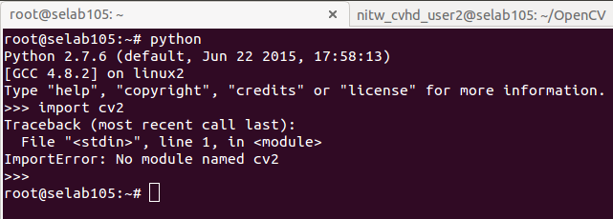
Then change the permissions for the file with
$chmod 777 opencv.sh
Then execute the script file as $./opencv.sh
Now open the terminal and type $python
Then the code as shown below
>>import cv2
If this gives an error, as shown below
Big Image Data Processing on Hadoop
Notes:
Now it is my privilege to present before you brief presentation about the department and detailed presentation for evaluating B Tech porgram in CSE in line with e-sar application submitted to NBA.

Slide 58
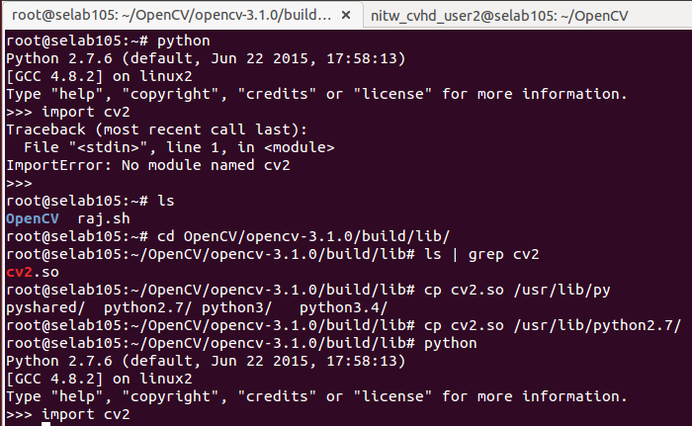
Perform the steps as shown in below image
Big Image Data Processing on Hadoop
Notes:
Now it is my privilege to present before you brief presentation about the department and detailed presentation for evaluating B Tech porgram in CSE in line with e-sar application submitted to NBA.

Slide 59
WebHDFS Rest-API
We use Rest-API of HDFS known as WebHDFS for handling with images and videos in Hadoop. To enable this, add the following two lines in hdfs-site.xml file:
Configuring hdfs-site.xml
<property>
<name>dfs.webhdfs.enabled</name>
<value>true</value>
</property>
Big Image Data Processing on Hadoop
Notes:
Now it is my privilege to present before you brief presentation about the department and detailed presentation for evaluating B Tech porgram in CSE in line with e-sar application submitted to NBA.

Slide 60
Creating Directory in HDFS
To create a directory named “input” in HDFS use the following command after starting Hadoop
$hdfs dfs –mkdir /user/nitw_cvhd_user2/input
Copying a image into HDFS
To copy a image named “input_image.jpg” into “input” directory in HDFS use the following command
$hdfs dfs –copyFromLocal <image_path> /user/nitw_cvhd_user2/input/input_image.jpg
Opening an image which is in HDFS using webhdfs
An image named “input_image.jpg” which is in directory named “input” in HDFS can now be opened using following URL
http://localhost:50070/webhdfs/v1/user/nitw_cvhd_user2/input/input_image.jpg?op=OPEN
Big Image Data Processing on Hadoop
Notes:
Now it is my privilege to present before you brief presentation about the department and detailed presentation for evaluating B Tech porgram in CSE in line with e-sar application submitted to NBA.

Slide 61
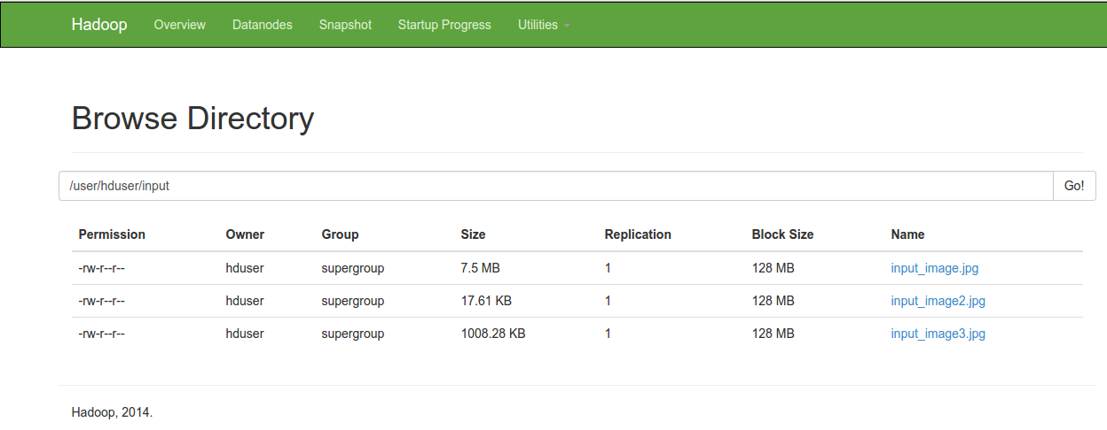
Creating 8 Bitmap images for an image in HDFS
The file named bitmap_hdfs.py has code for calculating 8 bitmap images for a given image where the input image is taken from HDFS and output images are written to local file system.
The following image shows the contents of input directory
Big Image Data Processing on Hadoop
Notes:
Now it is my privilege to present before you brief presentation about the department and detailed presentation for evaluating B Tech porgram in CSE in line with e-sar application submitted to NBA.

Slide 62
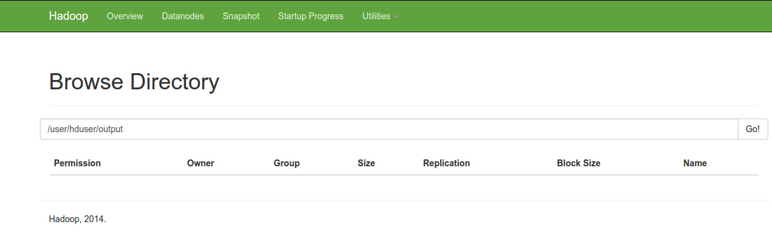
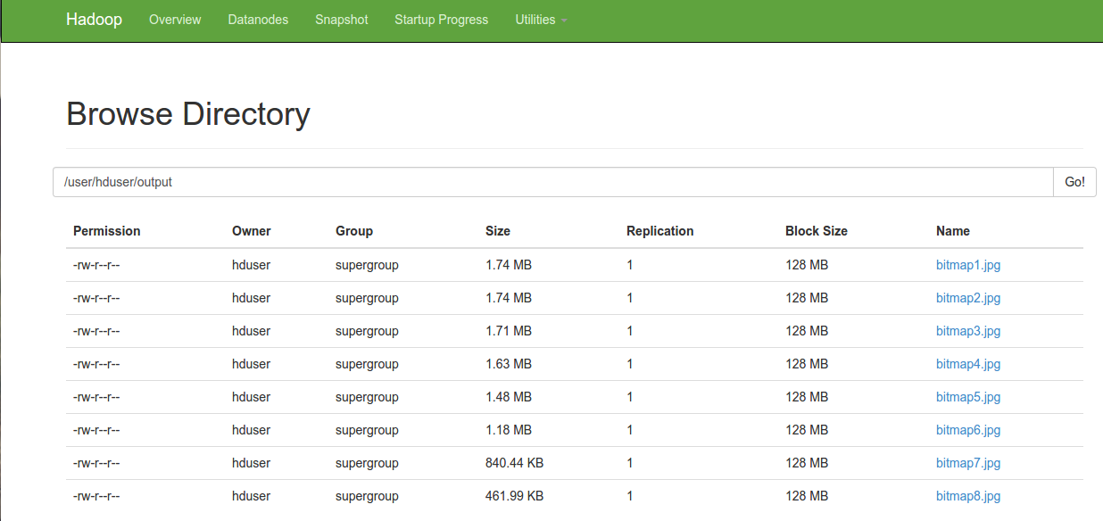
Creating 8 Bitmap images for an image in HDFS
The following images show the contents of output directory before and after putting output images into HDFS
Big Image Data Processing on Hadoop
Notes:
Now it is my privilege to present before you brief presentation about the department and detailed presentation for evaluating B Tech porgram in CSE in line with e-sar application submitted to NBA.

Slide 63

Creating 8 Bitmap images for an image in HDFS
The input image and corresponding output bitmap images will be as shown below
Big Image Data Processing on Hadoop
Notes:
Now it is my privilege to present before you brief presentation about the department and detailed presentation for evaluating B Tech porgram in CSE in line with e-sar application submitted to NBA.

Slide 64
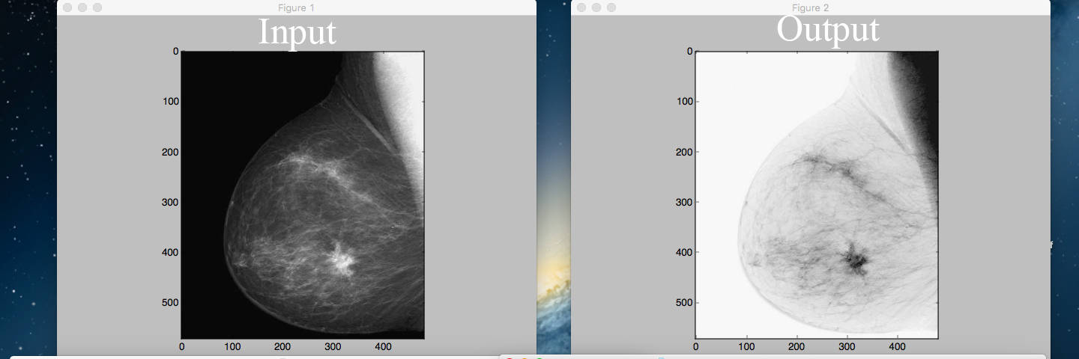
Generating negative of an image
The file named negative_hdfs.py has code for displaying negative image for a given image where the input image is taken from HDFS.
The following image shows the respective input and output
Big Image Data Processing on Hadoop
Notes:
Now it is my privilege to present before you brief presentation about the department and detailed presentation for evaluating B Tech porgram in CSE in line with e-sar application submitted to NBA.

Slide 65
Thank you …
Big Image Data Processing on Hadoop
Notes:
Now it is my privilege to present before you brief presentation about the department and detailed presentation for evaluating B Tech porgram in CSE in line with e-sar application submitted to NBA.

